Slide 1
Monolingual and Cross-lingual structured sentiment analysis

Slide 2
Motivation And Background
Products review are available over the internet.
Customer sentiments, insights and data hidden in the reviews.
Reviews can be about many different aspects of the product.

Slide 3
Problem Statement
To analyze and perform aspect based sentiment analysis over reviews dataset (i.e. Hotel reviews dataset semeval 2022 Codalab competition).
Identifying source and target and the sentiment of given review.

Slide 4
Aims and Objectives
The main aim of this is to research and propose a comparative study to aspect based sentiment analysis with hotel reviews dataset.
Objectives
To utilize various pre processing steps available for text processing.
To compare and contrast vectorization methods both frequency methods (bagofwords, TF-IDF) vs prediction based embedding techniques ( Word2Vec,GloVe).
To utilize existing libraries like TextBlob to prepare dataset for supervised problem.
To use many classification methods to classify the reviews to correct aspect and sentiments.

Slide 5
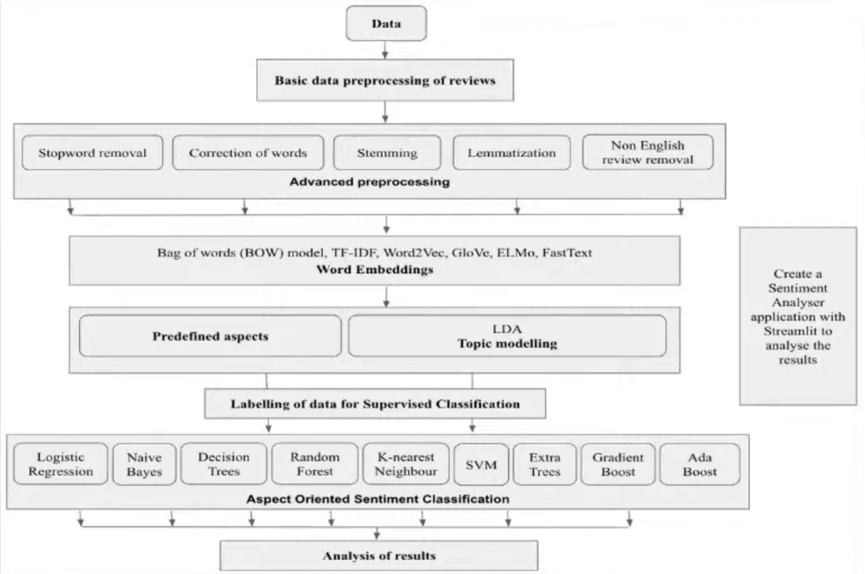
Methodology
The flowchart explains the step by step process followed in this mini project.
It also includes various models and methods used in steps.

Slide 6
Technologies used
Python
NLP toolkits
ML (numpy,pandas,scikt-learn)

Slide 7
Basic Data Pre-Processing
HTML tags removal
<> tags</>
Punctuation Removal
! . ? /
Number Removal
4,6,8
Text Lowering
I -> I
We and we

Slide 8
Advanced Data Pre-Processing
Stopwords Removals
Removal of words which do not have their own means.
i.e. at, then, should etc.
Stemming
Reducing a word to its stem or root.
Lemmatization
The root word is called a stem in the stemming process, and it is called a lemma in the lemmatization process.

Slide 9
One hot encoding
BOW(Bags of words)
CountVectorizer
TF-IDF(Term frequency – Inverse document frequency)
Tf-idfVectorizer

Slide 10
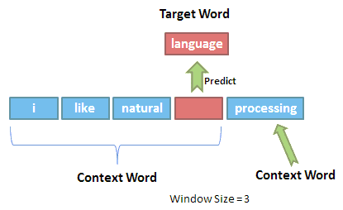
Word Embedding
Word2vec Architecture
Continuous bag of words (CBOW)
In CBOW, the current word is predicted using the window of surrounding context windows.
For example, if w_{i-1},w_{i-2},w_{i+1},w_{i+2}are given words or context, this model will provide w_{i}

Slide 11
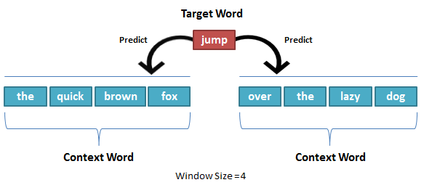
Word Embedding
Skipgram:
Skip-Gram performs opposite of CBOW which implies that it predicts the given sequence or context from the word.
You can reverse the example to understand it. If wi is given, this will predict the context or wi-1,wi-2,wi+1,wi+2.

Slide 12
Machine Learning Models
Logistic Regression
Random Forest
Naïve bayes

Slide 13
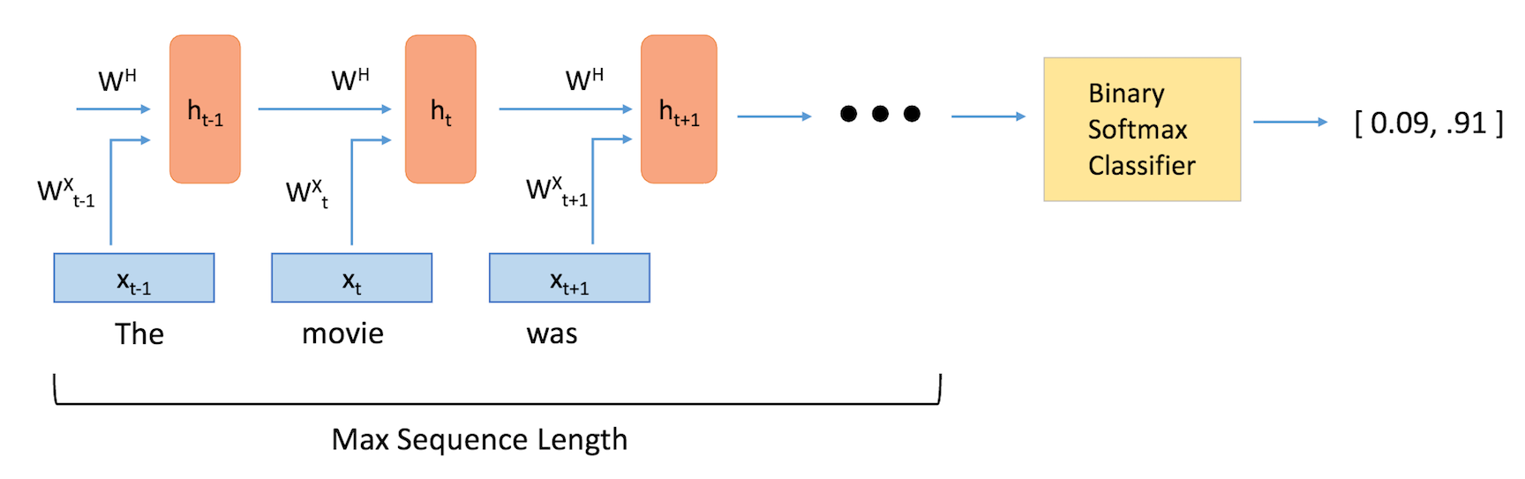
Deep Neural Network (LSTM)

Slide 14
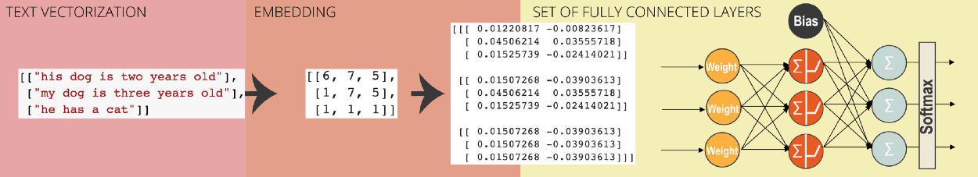
Deep Neural Network (LSTM) (Data preparation)

Slide 15
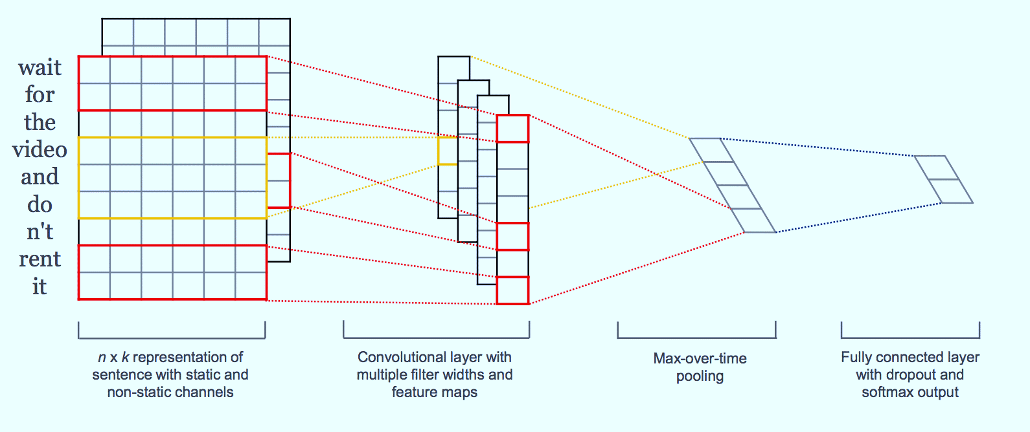
Deep Neural Network (CNN)

Slide 16
BERT
Bidirectional Encoder Representations from Transformers
Transformer Architecture Model
Transformer(NN) only performs a small, constant number of steps.
In each step, it applies a self-attention mechanism which directly models relationships between all words in a sentence, regardless of their respective position.
Ex: I arrived at the bank after crossing the river.
An attention score for every other word in the sentence is assigned.

Slide 17
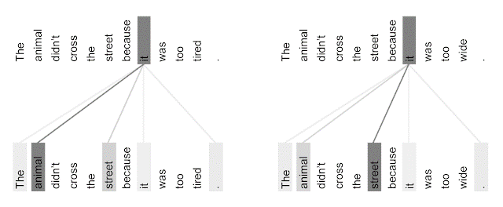
BERT

Slide 18
BERT
Credit: https://ai.googleblog.com/2017/08/transformer-novel-neural-network.html

Slide 19
Result
Model | Optimizers | Loss Function | Word embedding | Accuracy/F1 score
Logistic Regression |  | Rms with L2 norm | BOW | 0.74
 |  |  | TF-IDF | 0.74
Naïve Bayes |  | Bayes loss | BOW | 0.50
 |  |  | TF-IDF | 0.50
Random Forest |  |  | BOW | 0.74
LSTM | rmsprop | Binary crossentropy |  | 0.77
 | adam | Binary crossentropy |  | 0.79
CNN | rmsprop | Binary crossentropy |  | 0.74
 | adam | Binary crossentropy |  | 0.73
BERT(Base) |  |  |  | 0.95

Slide 20
Result With Intensity
Model | Optimizers | Loss Function | Word embedding | Accuracy/F1 score
Random Forest |  |  | BOW | 0.44
LSTM | rmsprop | Binary crossentropy |  | 0.71

Slide 21
References
https://cs229.stanford.edu/proj2014/Vikram%20Elango,%20Govindrajan%20Narayanan,%20Sentiment%20Analysis%20for%20Hotel%20Reviews.pdf
https://towardsdatascience.com/sentiment-analysis-for-hotel-reviews-3fa0c287d82e
https://monkeylearn.com/blog/word-embeddings-transform-text-numbers/
https://d2l.ai/chapter_natural-language-processing-applications/sentiment-analysis-rnn.html
https://d2l.ai/chapter_natural-language-processing-applications/sentiment-analysis-cnn.html
https://analyticsindiamag.com/how-to-implement-lstm-rnn-network-for-sentiment-analysis/
https://ai.googleblog.com/2017/08/transformer-novel-neural-network.html
https://towardsml.com/2019/09/17/bert-explained-a-complete-guide-with-theory-and-tutorial/

